Slide 1
Lecture 8: Memory Hierarchy
To watch lecture video click link below
Lecture 8a video
To view slides, continue to next slide

Slide 2
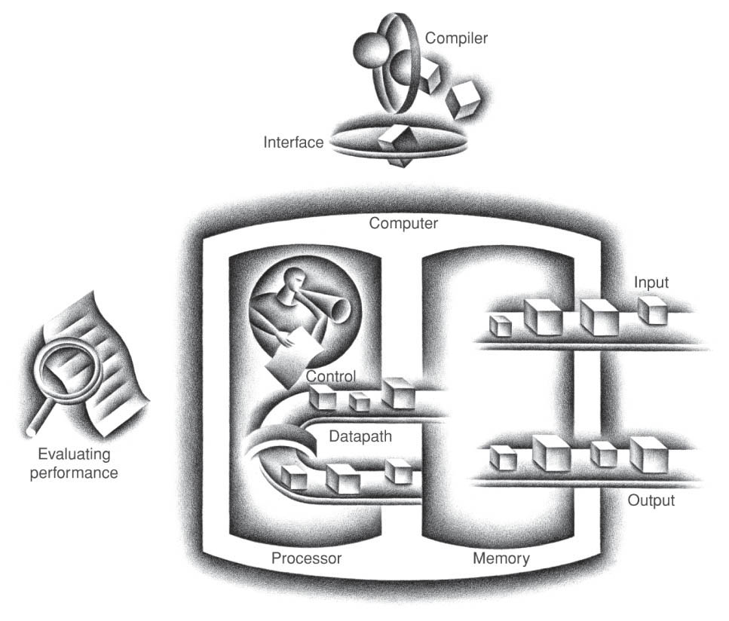
Lecture 8: Memory Hierarchy
This lecture covers the Memory Organization

Slide 3
Memory Components
SRAM:
value is stored on a pair of inverting gates
very fast but takes up more space than DRAM (4 to 6 transistors)
DRAM:
value is stored as a charge on capacitor (must be refreshed)
very small but slower than SRAM (factor of 5 to 10)

Slide 4
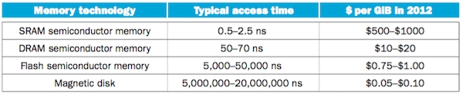
Memory Technology
Access time and Price
Ideal memory: users want large and fast memories!
Access time of SRAM
Capacity and cost/GB of disk

Slide 5
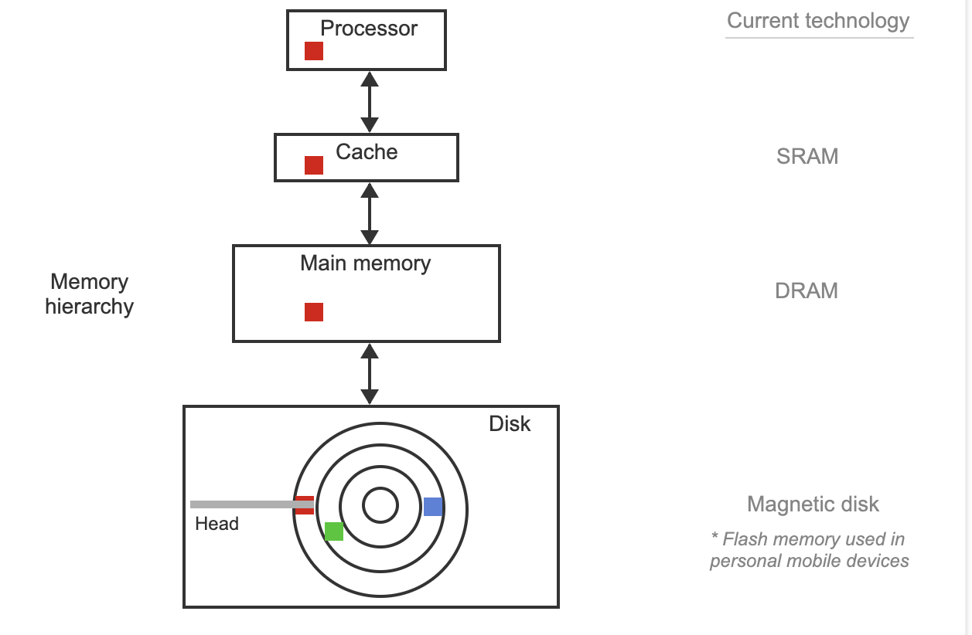
Memory Hierarchy: Current Technology

Slide 6
Lecture 8a: Basics of Cache
In this Module we will focus our discussions on cache. Lecture 8a on basics of cache and Lecture 8b on cache performance.

Slide 7
Cache
Meaning
A safe place for hiding or storing things – Webster’s Dictionary
Level of the memory hierarchy between processor and main memory
Two issues:
How do we know if a data item is in the cache?
If it is, how do we find it?
Basic Terms
block: minimum unit of data
hit: data requested is in the upper level (i.e. in cache)
miss: data requested is not in the upper level

Slide 8
Principles of Locality -- design foundation for Cache
Temporal locality
if an item is accessed, it will tend to be referenced again soon
e.g. if x is accessed, x will likely be accessed soon so keep/put x in cache.
Spatial locality
if an item is accessed, nearby items will tend to be referenced soon.
e.g. if an instruction fetched, the instruction stored next to it will likely to be fetched. So put a block of consecutive instructions in cache likely will benefit.
e.g. for (int i = 0; i< n; i++) sum += a[i];
If a[i] is accessed, likely a[i+1] will be accessed next.
A block of consecutive data in cache likely will benefit.

Slide 9
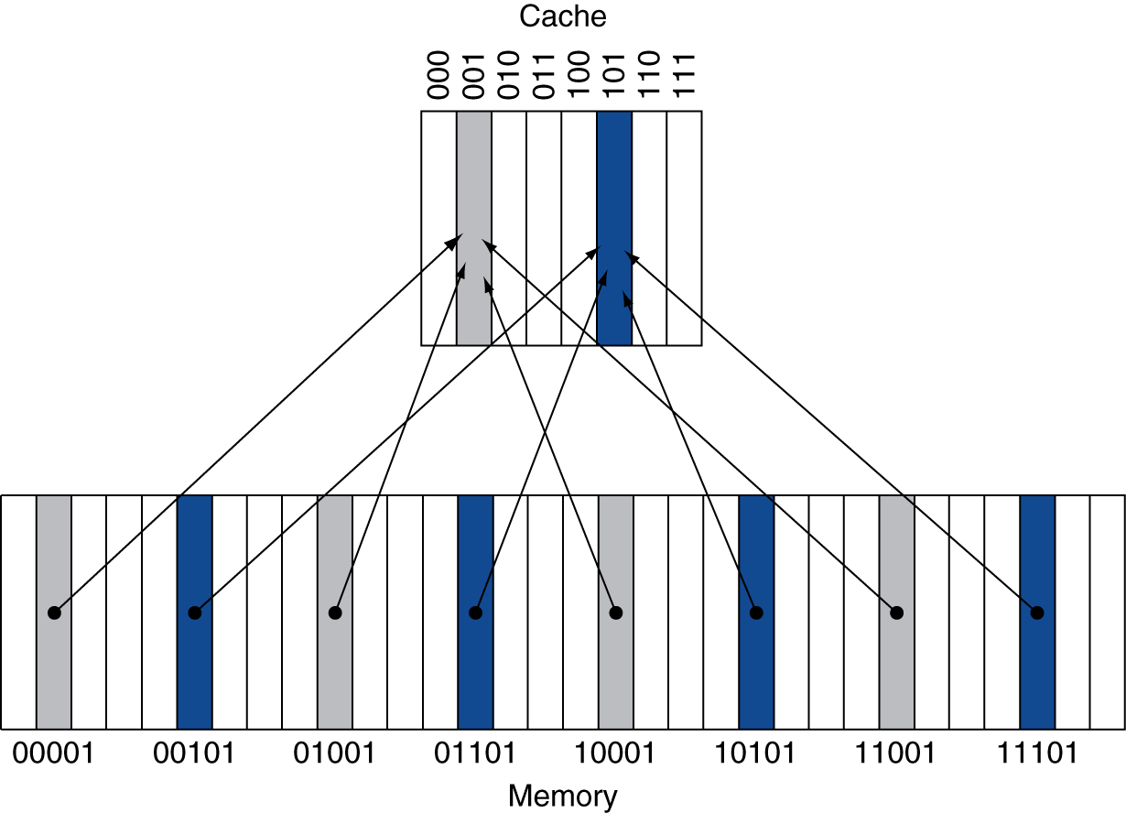
A Simple, Direct Mapped Cache
Block size: one word
Direct mapped: many to one mapping
A low level data can only be mapped to one location in cache (only one choice)
Different low level data may be mapped to the same location
Location determined by address
Cache address =
(memory address) mod (#Blocks in cache)
# of blocks: in power of 2
In this example:
Cache: 2³ blocks
addr mod 2³
⬄ take last 3 bits in addr
e.g. 11001 maps to 001.
(assume memory address is word address)

Slide 10
Practice
Assume we have a direct-mapped cache with 16 blocks, each block is one word.
Memory address is byte based. Assume memory address is 8-bit long.
What cache block address will each of the following memory addresses map to? (note: memory is byte-addressed.)
00111000, 11001100, 10111000
Can we map the following address to the cache? Why or why not?
00111010, 11001111

Slide 11
Tags and Valid Bit
How do we know which particular block is currently stored in a cache location?
Store block address as well as the data
Actually, only need to store the high-order bits
Lower bits of the address is the same as the cache address
Tag: the high/left part of the memory address stored in the cache along with the cached data
What if there is no data in a location?
Valid bit: 1 = present, 0 = not present
Initially 0

Slide 12
Cache Example
Cache organization: 8-blocks, 1 word/block, direct mapped
Initial state of the cache:
Index | V | Tag | Data
000 | N
001 | N
010 | N
011 | N
100 | N
101 | N
110 | N
111 | N

Slide 13
Cache Example
Word addr | Binary addr | Hit/miss | Cache block
22 | 10 110 | Miss | 110
Access a word in cache
Index | V | Tag | Data
000 | N
001 | N
010 | N
011 | N
100 | N
101 | N
110 | Y | 10 | Mem[10110]
111 | N
Miss, read from memory and then put it to cache, per temporal locality

Slide 14
Cache Example
Word addr | Binary addr | Hit/miss | Cache block
26 | 11 010 | Miss | 010
one more word
Index | V | Tag | Data
000 | N
001 | N
010 | Y | 11 | Mem[11010]
011 | N
100 | N
101 | N
110 | Y | 10 | Mem[10110]
111 | N
Miss, and update cache

Slide 15
Cache Example
Word addr | Binary addr | Hit/miss | Cache block
22 | 10 110 | Hit | 110
26 | 11 010 | Hit | 010
two more words
Index | V | Tag | Data
000 | N
001 | N
010 | Y | 11 | Mem[11010]
011 | N
100 | N
101 | N
110 | Y | 10 | Mem[10110]
111 | N
Hit, read from cache directly

Slide 16
Cache Example
Word addr | Binary addr | Hit/miss | Cache block
16 | 10 000 | Miss | 000
3 | 00 011 | Miss | 011
16 | 10 000 | Hit | 000
more accesses
Index | V | Tag | Data
000 | Y | 10 | Mem[10000]
001 | N
010 | Y | 11 | Mem[11010]
011 | Y | 00 | Mem[00011]
100 | N
101 | N
110 | Y | 10 | Mem[10110]
111 | N
Updated cache content

Slide 17
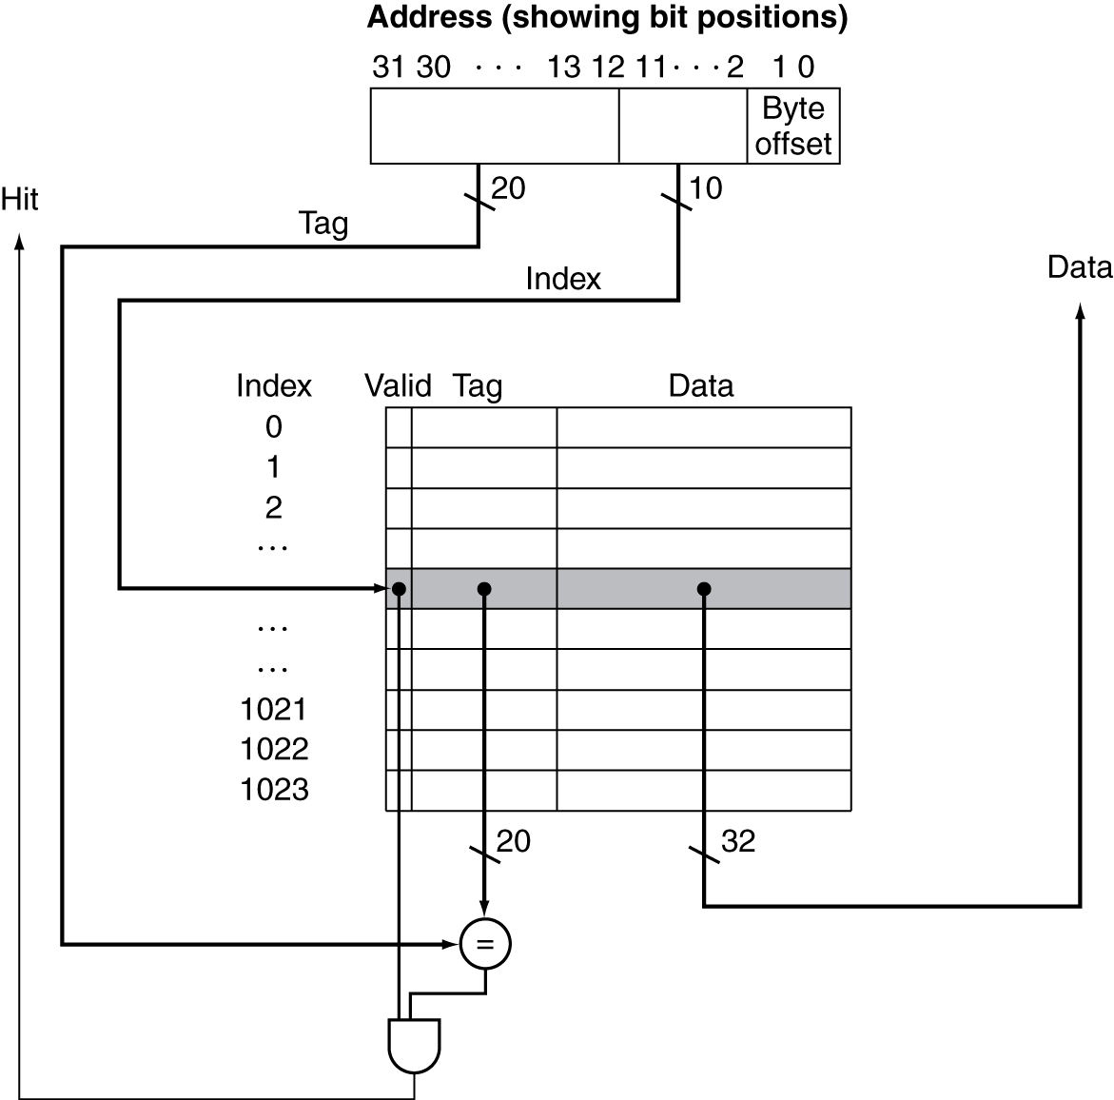
Implementation of Direct-mapped Cache
32-bit memory address
Data found in cache if hit == 1
Hit =1
if Valid=1 && tag==upper_addr
A 4KB cache
(each block is 1 word, so total 1K blocks)

Slide 18
Hit and Miss
hit: data requested found in cache
Data is sent from cache to processor datapath directly
This makes it possible for the memory (IM/DM) read in 1 cycle
miss: data requested is not cache
In case of cache miss, the pipeline will be stalled
Read data from the memory (many more cycles)
Put it in cache
According to temporal locality, if a data is accessed, likely it will be used again soon
Send to the processor datapath
Cache miss penalty
Much larger than pipeline hazard penalty
For example: 10-20 cycles

Slide 19
Summary
Memory hierarchy
The fastest (also smallest due to cost) is closest to processor
Larger (and cheaper) memory in lower level
Caching, a strategy that
views the memory as the largest one
accesses via the fastest one first
Concepts of Cache
Principle of locality
Programs use a small part of the memory space frequently
Direct-mapped cache principles and organization

